Slide 1
Analytical Modeling of Parallel Systems
Ananth Grama, Anshul Gupta, George Karypis, and Vipin Kumar
To accompany the text ``Introduction to Parallel Computing'',
Addison Wesley, 2003.

Slide 2
Topic Overview
Sources of Overhead in Parallel Programs
Performance Metrics for Parallel Systems
Effect of Granularity on Performance
Scalability of Parallel Systems
Minimum Execution Time and Minimum Cost-Optimal Execution Time
Asymptotic Analysis of Parallel Programs
Other Scalability Metrics

Slide 3
Analytical Modeling - Basics
A sequential algorithm is evaluated by its runtime (in general, asymptotic runtime as a function of input size).
The asymptotic runtime of a sequential program is identical on any serial platform.
The parallel runtime of a program depends on the input size, the number of processors, and the communication parameters of the machine.
An algorithm must therefore be analyzed in the context of the underlying platform.
A parallel system is a combination of a parallel algorithm and an underlying platform.
We will discuss various metrics for evaluating the performance of parallel systems.

Slide 4
Analytical Modeling - Basics
A number of performance measures are intuitive.
Wall clock time - the time from the start of the first processor to the stopping time of the last processor in a parallel ensemble. But how does this scale when the number of processors is changed of the program is ported to another machine altogether?
How much faster is the parallel version? This begs the obvious followup question - whats the baseline serial version with which we compare?
Raw FLOP count

Slide 5
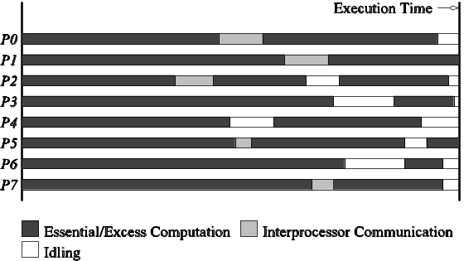
Sources of Overhead in Parallel Programs
If I use two processors, shouldnt my program run twice as fast?
No - a number of overheads, including wasted computation, communication, idling, and contention cause degradation in performance.
The execution profile of a hypothetical parallel program executing on eight processing elements. Profile indicates times spent performing computation (both essential and excess), communication, and idling.

Slide 6
Sources of Overheads in Parallel Programs
Interprocess interactions: Processors working on any non-trivial parallel problem will need to talk to each other.
Idling: Processes may idle because of load imbalance, synchronization, or serial components.
Excess Computation: This is computation not performed by the serial version. This might be because the serial algorithm is difficult to parallelize, or that some computations are repeated across processors to minimize communication. E.g. fast Fourier transform
In serial version the results of certain computations can be reused. However in parallel version these results cannot be reused because they are generated by different processing elements

Slide 7
Performance Metrics for Parallel Systems: Execution
Time
It is important to study the performance of parallel programs with a view to determining the best algo, evaluating hardware platforms and examining the benefits from parallelism.
Execution time
Serial runtime of a program is the time elapsed between the beginning and the end of its execution on a sequential computer.
The parallel runtime is the time that elapses from the moment the first processor starts to the moment the last processor finishes execution.
We denote the serial runtime by Ts and the parallel runtime by T_{P} .

Slide 8
Performance Metrics for Parallel Systems: Total Parallel Overhead
Let T_{all} be the total time collectively spent by all the processing elements.
T_{S} is the serial time.
Observe that T_{all} - T_{S} is then the total time spend by all processors combined in non-useful work. This is called the total overhead.
The total time collectively spent by all the processing elements
  T_{all} = p T_{P} (p is the number of processors).
The overhead function (T_{o}) is therefore given by
T_{o} = p T_{P} - T_{S} (1)

Slide 9
Performance Metrics for Parallel Systems: Speedup
What is the benefit from parallelism? i.e. How much performance gain is achieved by parallelizing a given application ?
Speedup (S) is the ratio of the time taken to solve a problem on a single processor to the time required to solve the same problem on a parallel computer with p identical processing elements.

Slide 10
Performance Metrics: Example
Consider the problem of adding n numbers by using n processing elements.
If n is a power of two, we can perform this operation in log n steps by propagating partial sums up a logical binary tree of processors.

Slide 11
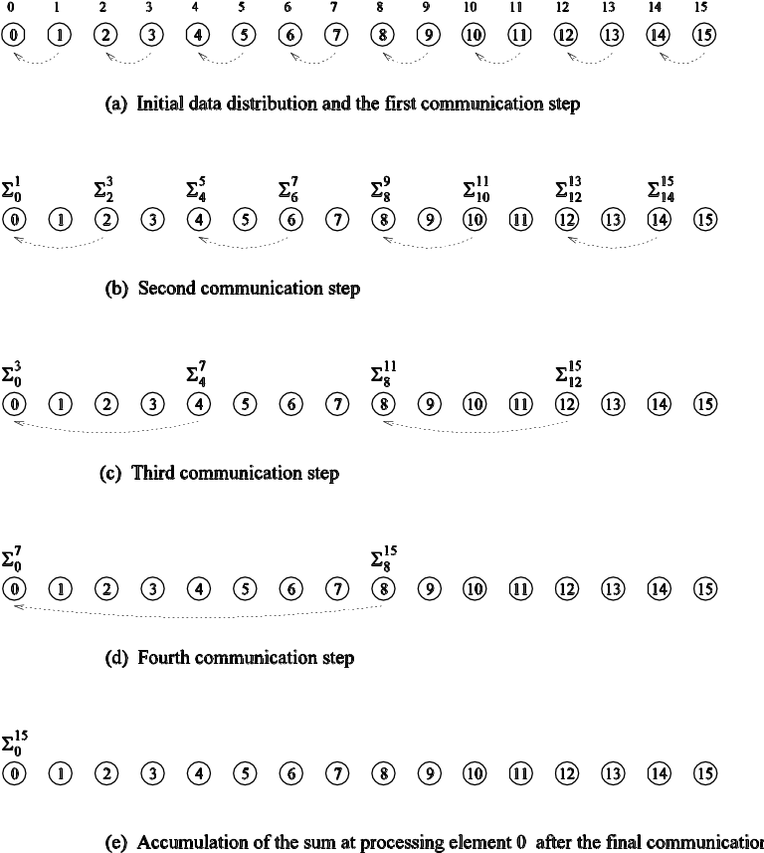
Performance Metrics: Example
Computing the globalsum of 16 partial sums using 16 processing elements . Σ^{j}_{i} denotes the sum of numbers with consecutive labels from i to j.

Slide 12
Performance Metrics: Example (continued)
If an addition takes constant time, say, t_{c} and communication
of a single word takes time t_{s} + t_{w}, we have the parallel time
T_{P} = Θ (log n)
We know that T_{S} = Θ (n)
Speedup S is given by S = Θ (n / log n)

Slide 13
Performance Metrics: Speedup
For a given problem, there might be many serial algorithms available. These algorithms may have different asymptotic runtimes and may be parallelizable to different degrees.
For the purpose of computing speedup, we always consider the best sequential program as the baseline.

Slide 14
Performance Metrics: Speedup Example
Consider the problem of parallel bubble sort.
The serial time for bubblesort is 150 seconds.
The parallel time for odd-even sort (efficient parallelization of bubble sort) is 40 seconds.
The speedup would appear to be 150/40 = 3.75.
But is this really a fair assessment of the system?
What if serial quicksort only took 30 seconds? In this case, the speedup is 30/40 = 0.75. This is a more realistic assessment of the system.

Slide 15
Performance Metrics: Speedup Bounds
Speedup can be as low as 0 (the parallel program never terminates).
Speedup, in theory, should be upper bounded by p - after all, we can only expect a p-fold speedup if we use times as many resources.
A speedup greater than p is possible only if each processing element spends less than time T_{S} / p solving the problem.
In this case, a single processor could emulate p processing elements to achieve a faster serial program, which contradicts our assumption of fastest serial program as basis for speedup.
Speed up greater than p is sometimes observed known as superlinear speedup

Slide 16
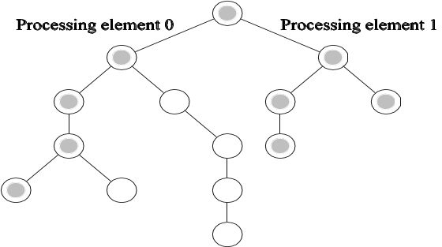
Performance Metrics: Superlinear Speedups
One reason for superlinearity is that the parallel version does less work than corresponding serial algorithm.
Searching an unstructured tree for a node with a given label, `S', on two processing elements using depth-first traversal. The two-processor version with processor 0 searching the left subtree and processor 1 searching the right subtree expands only the shaded nodes before the solution is found. The corresponding serial formulation expands the entire tree. It is clear that the serial algorithm does more work than the parallel algorithm.

Slide 17
Performance Metrics: Superlinear Speedups
Resource-based superlinearity: The higher aggregate cache/memory bandwidth can result in better cache-hit ratios, and therefore superlinearity.
Example: A processor with 64KB of cache yields an 80% hit ratio. If two processors are used, since the problem size/processor is smaller, the hit ratio goes up to 90%. Of the remaining 10% access, 8% come from local memory and 2% from remote memory.
If DRAM access time is 100 ns, cache access time is 2 ns, and remote memory access time is 400ns, this corresponds to a speedup of 2.43!

Slide 18


Performance Metrics: Efficiency
Efficiency is a measure of the fraction of time for which a processing element is usefully employed it is the ratio of speedup to the number of processing elements.
Mathematically, it is given by
= (2)
Following the bounds on speedup, efficiency can be as low as 0 and as high as 1.

Slide 19

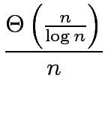

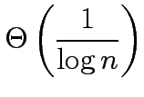
Performance Metrics: Efficiency Example
The speedup of adding numbers on processors is given by
Efficiency is given by
=
=

Slide 20
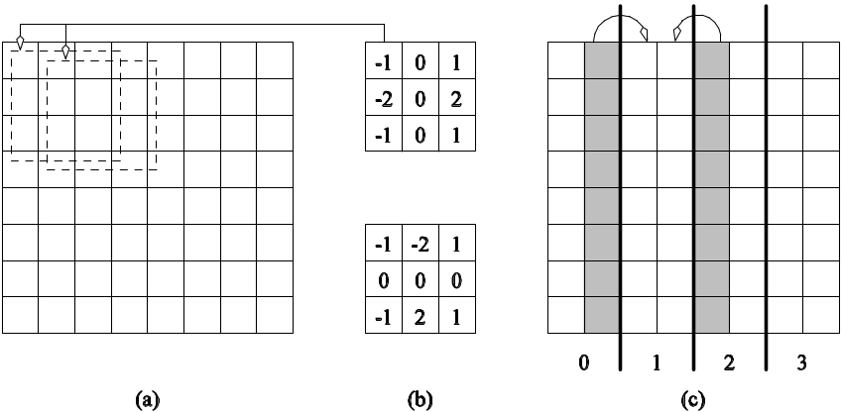
Parallel Time, Speedup, and Efficiency Example
Consider the problem of edge-detection in images. an edge is a set of connected pixels that lies on boundary bet two regions that differ in grey value. problem requires us to apply a 3 x 3 template to each pixel. If each multiply-add operation takes time t_{c}, the serial time for an n x n image is given by T_{S}= 9t_{c} n².
Example of edge detection: (a) an 8 x 8 image; (b) typical templates for detecting edges; and (c) partitioning of the image across four processors with shaded regions indicating image data that must be communicated from neighboring processors to processor 1.

Slide 21
Parallel Time, Speedup, and Efficiency Example (continued)
One possible parallelization partitions the image equally into vertical segments, each with n² / p pixels.
The boundary of each segment is 2n pixels. This is also the number of pixel values that will have to be communicated. This takes time 2(t_{s} + t_{w}n).
Templates may now be applied to all n² / p pixels in time
T_{S} = 9 t_{c}n² / p.

Slide 22
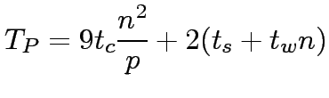
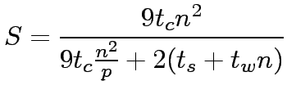
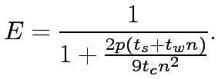
Parallel Time, Speedup, and Efficiency Example (continued)
The total time for the algorithm is therefore given by:
The corresponding values of speedup and efficiency are given by:
and

Slide 23
Cost of a Parallel System
Cost is the product of parallel runtime and the number of processing elements used (p x T_{P} ).
Cost reflects the sum of the time that each processing element spends solving the problem.
A parallel system is said to be cost-optimal if the cost of solving a problem on a parallel computer is asymptotically identical to serial cost.
Since E = T_{S} / p T_{P}, for cost optimal systems, E = O(1).
Cost is sometimes referred to as work or processor-time product.

Slide 24
Cost of a Parallel System: Example
Consider the problem of adding numbers on processors.
We have, T_{P} = log n (for p = n).
The cost of this system is given by p T_{P} = n log n.
Since the serial runtime of this operation is Θ(n), the algorithm is not cost optimal.

Slide 25
Impact of Non-Cost Optimality
Consider a sorting algorithm that uses n processing elements to sort the list in time (log n)².
Since the serial runtime of a (comparison-based) sort is n log n, the speedup and efficiency of this algorithm are given by n / log n and 1 / log n, respectively.
The p T_{P} product of this algorithm is n (log n)².
This algorithm is not cost optimal but only by a factor of log n.
If p < n, assigning n tasks to p processors gives T_{P} = n (log n)² / p .
The corresponding speedup of this formulation is p / log n.
This speedup goes down as the problem size n is increased for a given p ! This emphasis the practical importance of cost optimally

Slide 26
Effect of Granularity on Performance
Often, using fewer processors improves performance of parallel systems. We assign larger pieces of input data. Increase granuality of computation
Using fewer than the maximum possible number of processing elements to execute a parallel algorithm is called scaling down a parallel system.
A naive way of scaling down is to think of each processor in the original case as a virtual processor and to assign virtual processors equally to scaled down processors.
Since the number of processing elements decreases by a factor of n / p, the computation at each processing element increases by a factor of n / p.
The communication cost should not increase by this factor since some of the virtual processors assigned to a physical processors might talk to each other. This is the basic reason for the improvement from building granularity. Total run time increases by factor n/p but processor time product does not increase

Slide 27
Building Granularity: Example
Consider the problem of adding n numbers on p processing elements such that p < n and both n and p are powers of 2.
Use the parallel algorithm for n processors, except, in this case, we think of them as virtual processors.
Each of the p processors is now assigned n / p virtual processors.
The first log p of the log n steps of the original algorithm are simulated in (n / p) log p steps on p processing elements.
Subsequent log n - log p steps do not require any communication because processing elements that communicate in the original algorithm are simulated by the same processing element

Slide 28
Building Granularity: Example (continued)
The overall parallel execution time of this parallel system is
Θ ( (n / p) log p).
The cost is Θ (n log p), which is asymptotically higher than the Θ (n) cost of adding n numbers sequentially. Therefore, the parallel system is not cost-optimal.

Slide 29
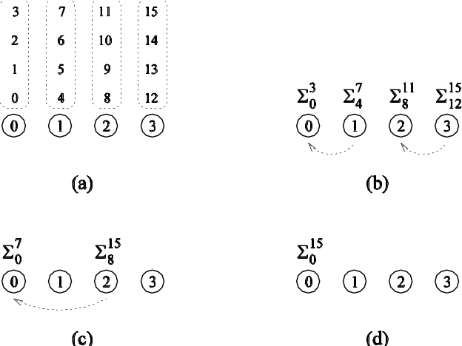
Building Granularity: Example (continued)
Can we build granularity in the example in a cost-optimal fashion?
Each processing element locally adds its n / p numbers in time Θ (n / p).
The p partial sums on p processing elements can be added in time Θ(log p).
A cost-optimal way of computing the sum of 16 numbers using four processing elements.

Slide 30



Building Granularity: Example (continued)
The parallel runtime of this algorithm is
(3)
The cost is
This is cost-optimal, so long as !
Manner in which the computation is mapped onto processing elements may determine whether system is cost optimal or not

Slide 31
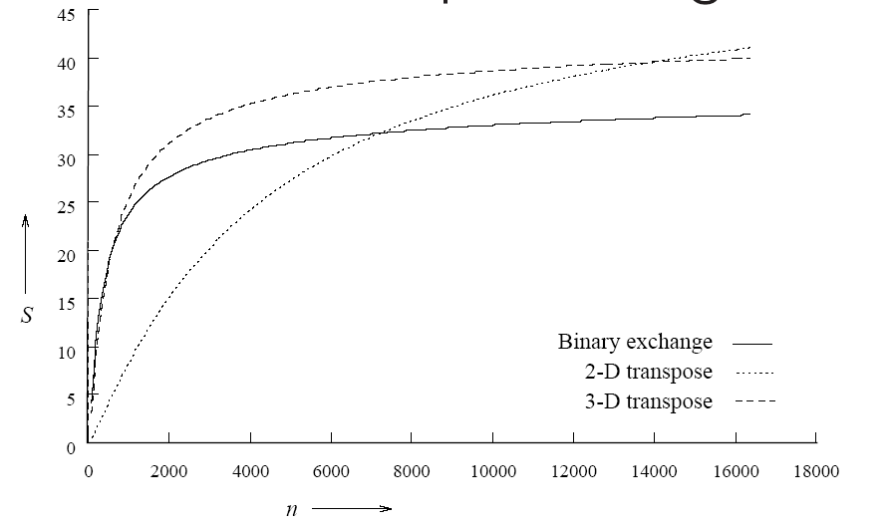
Scalability of Parallel Systems
How do we extrapolate performance from small problems and small systems to larger problems on larger configurations?
Consider three parallel algorithms for computing an n-point Fast Fourier Transform (FFT) on 64 processing elements.
A comparison of the speedups obtained by the binary-exchange, 2-D transpose and 3-D transpose algorithms on 64 processing elements with t_{c} = 2, t_{w} = 4, t_{s} = 25, and t_{h} = 2.
Clearly, it is difficult to infer scaling characteristics from observations on small datasets on small machines.

Slide 32
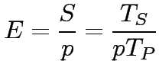

Scaling Characteristics of Parallel Programs
The efficiency of a parallel program can be written as:
or (4)
The total overhead function T_{o} is an increasing function of p .because every program must contain some serial component. So other processing elements must be idle.

Slide 33
Scaling Characteristics of Parallel Programs
For a given problem size (i.e., the value of T_{S} remains constant), as we increase the number of processing elements, T_{o} increases.
The overall efficiency of the parallel program goes down. This is the case for all parallel programs.

Slide 34
Amdahl's law
It is often used in parallel computing to predict the theoretical maximum speedup using multiple processors.
f is fraction of work that cannot be divided into concurrent task
So time to perform computation with p processor is
fts +(1-f)ts/p
S=ts/(fts + (1-f)ts/p) = p/(1+(p-1)f)
Even infinite number of processor the maximum speed is limited to 1/f
Eg. 5% of the computation is serial speed up is 20%

Slide 35




Scaling Characteristics of Parallel Programs: Example
Consider the problem of adding numbers on processing elements.
We have seen that:
= (5)
= (6)
= (7)

Slide 36
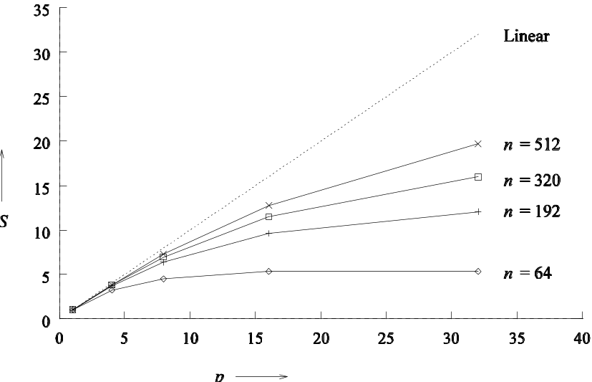
Scaling Characteristics of Parallel Programs: Example (continued)
Plotting the speedup for various input sizes gives us:
Speedup versus the number of processing elements for adding a list of numbers
a large instance of same problem yields larger speedup and efficiency for the same number of processing elements.
Speedup tends to saturate and efficiency drops as a consequence of Amdahl's law

Slide 37
Scaling Characteristics of Parallel Programs
Total overhead function T_{o} is a function of both problem size T_{s} and the number of processing elements p.
In many cases, T_{o} grows sublinearly with respect to T_{s}.
In such cases, the efficiency increases if the problem size is increased keeping the number of processing elements constant.
For such systems, we can simultaneously increase the problem size and number of processors to keep efficiency constant.
We call such systems scalable parallel systems.
The scalability is a measure of its capacity to increase speedup in proportion to the number of processing elements. It reflects the system’s ability to utilize increasing processing resources effectively

Slide 38
Scaling Characteristics of Parallel Programs
Recall that cost-optimal parallel systems have an efficiency of Θ(1).
Scalability and cost-optimality are therefore related.
A scalable parallel system can always be made cost-optimal if the number of processing elements and the size of the computation are chosen appropriately.
E.g. adding n number on p processing element is cost optimal when
n=▫plogp

Slide 39
Isoefficiency Metric of Scalability
For a given problem size, as we increase the number of processing elements, the overall efficiency of the parallel system goes down for all systems.
For some systems, the efficiency of a parallel system increases if the problem size is increased while keeping the number of processing elements constant.

Slide 40
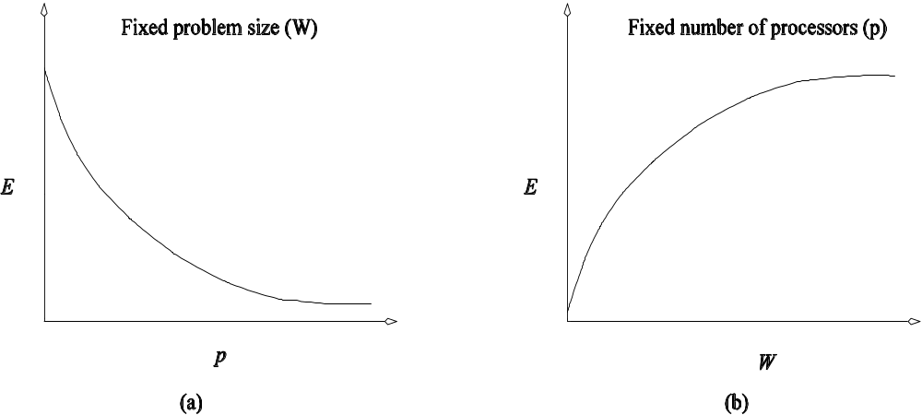
Isoefficiency Metric of Scalability
Variation of efficiency: (a) as the number of processing elements is increased for a given problem size; and (b) as the problem size is increased for a given number of processing elements. The phenomenon illustrated in graph (b) is not common to all parallel systems.

Slide 41
Isoefficiency Metric of Scalability
What is the rate at which the problem size must increase with respect to the number of processing elements to keep the efficiency fixed?
This rate determines the scalability of the system. The slower this rate, the better.
Before we formalize this rate, we define the problem size W as the asymptotic number of operations associated with the best serial algorithm to solve the problem.
E.g.ⱷ(n3) in matrix multiplication
W equals to serial runtime Ts of the fastest known algorithm to solve problem on sequential computer.

Slide 42
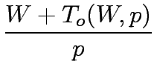


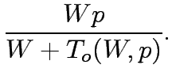

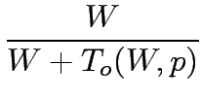

Isoefficiency Metric of Scalability
We can write parallel runtime as:
(8)
The resulting expression for speedup is
(9)
Finally, we write the expression for efficiency as

Slide 43

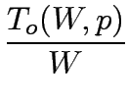
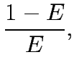

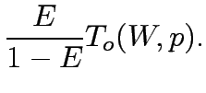

Isoefficiency Metric of Scalability
For scalable parallel systems, efficiency can be maintained at a fixed value (between 0 and 1) if the ratio T_{o} / W is maintained at a constant value. Different system W must be increased at different rate
Poorly scalable :W might grow exponential with p
Highly scalable : W needs to grow linearly with p
For a desired value E of efficiency,
(11)
If K = E / (1 – E) is a constant depending on the efficiency to be maintained, since T_{o} is a function of W and p, we have
(12)

Slide 44
Isoefficiency Metric of Scalability
The problem size W can usually be obtained as a function of p by algebraic manipulations to keep efficiency constant.
This function is called the isoefficiency function.
This function determines the ease with which a parallel system can maintain a constant efficiency and hence achieve speedups increasing in proportion to the number of processing elements t
A small isoefficiency function means that small increments in the problem size are sufficient for the efficient utilization of an increasing p, indicating tha parallel system is highly scalable
Large isoefficiency function indicates poorly scalable parallel system. The isoefficiency function does not exist for unscabalable parallel systems because in such systems the efficiency cannot be kept at any constant value as p increases no matter how fast the problem size increased

Slide 45


Isoefficiency Metric: Example
The overhead function for the problem of adding n numbers on p processing elements is approximately 2p log p .
Substituting T_{o} by 2p log p , we get
= (13)
Thus, the asymptotic isoefficiency function for this parallel system is
.
If the number of processing elements is increased from p to p’, the problem size (in this case, n ) must be increased by a factor of (p’ log p’) / (p log p) to get the same efficiency as on p processing elements.

Slide 46






Isoefficiency Metric: Example
in above example overhead is function of p only
Consider a more complex example where
Balance W against each term of T0
Using only the first term of T_{o} in Equation 12, we get
= (14)
Using only the second term, Equation 12 yields the following relation between W and p:
(15)
The larger of these two asymptotic rates determines the isoefficiency. This is given by Θ(p³)

Slide 47

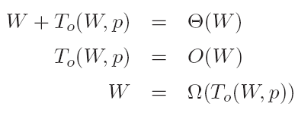
Cost-Optimality and the Isoefficiency Function
A parallel system is cost-optimal if and only if
(16)
From this, we have:
(17)
(18)
Parallel system is cost optimal if and only if its overhead function does not asymptotically exceed the problem size
If we have an isoefficiency function f(p), then it follows that the relation W = Ω(f(p)) must be satisfied to ensure the cost-optimality of a parallel system as it is scaled up.

Slide 48
Lower Bound on the Isoefficiency Function
For a problem consisting of W units of work, no more than W processing elements can be used cost-optimally.
The problem size must increase at least as fast as Θ(p) to maintain fixed efficiency; hence, Ω(p) is the asymptotic lower bound on the isoefficiency function.

Slide 49
Degree of Concurrency and the Isoefficiency Function
The maximum number of tasks that can be executed simultaneously at any time in a parallel algorithm is called its degree of concurrency.
If C(W) is the degree of concurrency of a parallel algorithm, then for a problem of size W, no more than C(W) processing elements can be employed effectively.

Slide 50
Degree of Concurrency and the Isoefficiency Function: Example
Consider solving a system of equations in variables by using Gaussian elimination (W = Θ(n³))
The n variables must be eliminated one after the other, and eliminating each variable requires Θ(n²) computations.
At most Θ(n²) processing elements can be kept busy at any time.
Since W = Θ(n³) for this problem, the degree of concurrency C(W) is Θ(W^{2/3}) .
Given p processing elements, the problem size should be at least Ω(p^{3/2}) to use them all.

Slide 51

Minimum Execution Time and Minimum Cost-Optimal Execution Time
Often, we are interested in the minimum time to solution.
We can determine the minimum parallel runtime T_{P}^{min} for a given W by differentiating the expression for T_{P} w.r.t. p and equating it to zero.
= 0 (19)
If p₀ is the value of p as determined by this equation, T_{P}(p₀) is the minimum parallel time.

Slide 52



Minimum Execution Time: Example
Consider the minimum execution time for adding n numbers.
= (20)
Setting the derivative w.r.t. p to zero, we have p = n/ 2 . The corresponding runtime is
= (21)
(One may verify that this is indeed a min by verifying that the second derivative is positive).
Note that at this point, the formulation is not cost-optimal.

Slide 53
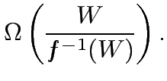

Minimum Cost-Optimal Parallel Time
Let T_{P}^{cost_opt} be the minimum cost-optimal parallel time.
If the isoefficiency function of a parallel system is Θ(f(p)) , then a problem of size W can be solved cost-optimally if and only if
W= Ω(f(p)) .
In other words, for cost optimality, p = O(f⁻⁻¹(W)) .
For cost-optimal systems, T_{P} = Θ(W/p) , therefore,
= (22)

Slide 54
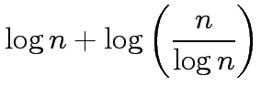

Minimum Cost-Optimal Parallel Time: Example
Consider the problem of adding n numbers.
The isoefficiency function f(p) of this parallel system is Θ(p log p).
From this, we have p ≈ n /log n .
At this processor count, the parallel runtime is:
=
= (23)
Note that both T_{P}^{min} and T_{P}^{cost_opt} for adding n numbers are
Θ(log n).. Parallel time cannot be reduced by using value of p greater than that suggested by isoefficiency function. This may not always be the case

Slide 55
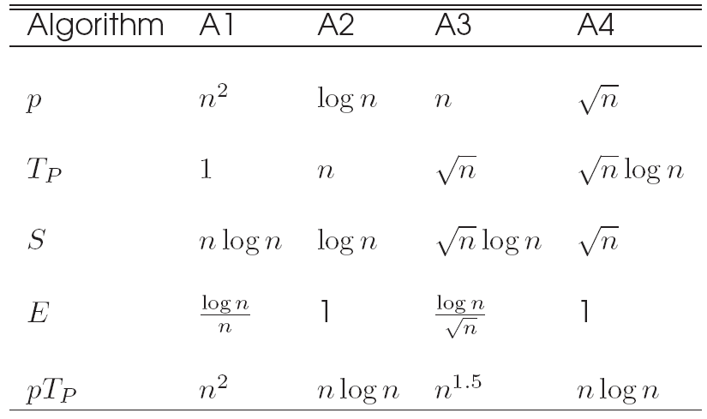
Asymptotic Analysis of Parallel Programs
Consider the problem of sorting a list of n numbers. The fastest serial programs for this problem run in time Θ(n log n). Consider four parallel algorithms, A1, A2, A3, and A4 as follows:
Comparison of four different algorithms for sorting a given list of numbers. The table shows number of processing elements, parallel runtime, speedup, efficiency and the pT_{P} product.

Slide 56
Asymptotic Analysis of Parallel Programs
If the metric is speed, algorithm A1 is the best, followed by A3, A4, and A2 (in order of increasing T_{P}).
In terms of efficiency, A2 and A4 are the best, followed by A3 and A1.
In terms of cost, algorithms A2 and A4 are cost optimal, A1 and A3 are not.
It is important to identify the objectives of analysis and to use appropriate metrics! Use of different metrices may often result in contradictory outcomes

Slide 57
Other Scalability Metrics
A number of other metrics have been proposed, dictated by specific needs of applications.
For real-time applications, the objective is to scale up a system to accomplish a task in a specified time bound. E.g. multimedia decompression where MPEG streams must be decompressed at the rate 25 frames/sec i.e. system must decode frame in 40ms
In many application the maximum size of a problem is constrained not by time, efficiency but the memory available. In memory constrained environments, metrics operate at the limit of memory and estimate performance under this problem growth rate.

Slide 58
Other Scalability Metrics: Scaled Speedup
Speedup obtained when the problem size is increased linearly with the number of processing elements.
If scaled speedup is close to linear, the system is considered scalable.
If the isoefficiency is near linear, scaled speedup curve is close to linear as well.
If the aggregate memory grows linearly in p, scaled speedup increases problem size to fill memory.
Alternately, the size of the problem is increased with p subject to an upper-bound on parallel execution time.

Slide 59
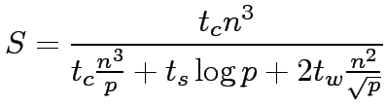
Scaled Speedup: Example
The serial runtime of multiplying a matrix of dimension n x n with a vector is t_{c}n² .
For a given parallel algorithm,
(24)
Total memory requirement of this algorithm is Θ(n²) .

Slide 60


Scaled Speedup: Example (continued)
Consider the case of memory-constrained scaling.
We have m= Θ(n²) = Θ(p).memory grows lineary with p
Memory constrained scaled speedup is given by
or
This is not a particularly scalable system

Slide 61
Scaled Speedup: Example (continued)
Consider the case of time-constrained scaling.
We have T_{P} = O(n²) .
Since this is constrained to be constant, n²= O(p) .
Note that in this case, time-constrained speedup is identical to memory constrained speedup.
This is not surprising, since the memory and time complexity of the operation are identical.

Slide 62
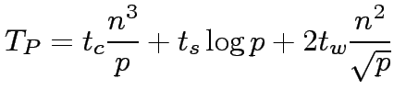
Scaled Speedup: Example
The serial runtime of multiplying two matrices of dimension n x n is t_{c}n³.
The parallel runtime of a given algorithm is:
The speedup S is given by:
(25)

Slide 63
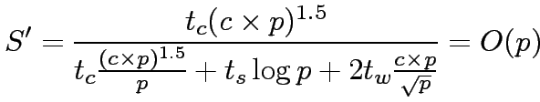
Scaled Speedup: Example (continued)
Consider memory-constrained scaled speedup.
We have memory complexity m= Θ(n²) = Θ(p), or n²=c x p .
At this growth rate, scaled speedup S’ is given by:
Note that this is scalable.

Slide 64
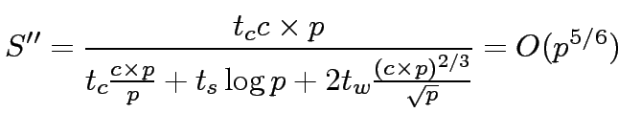
Scaled Speedup: Example (continued)
Consider time-constrained scaled speedup.
We have T_{P} = O(1) = O(n³ / p) , or n³=c x p .
Time-constrained speedup S’’ is given by:
Memory constrained scaling yields better performance.

Slide 65

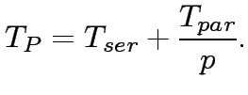
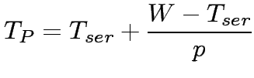
Serial Fraction f
If the serial runtime of a computation can be divided into a totally parallel and a totally serial component, we have:
From this, we have,
(26)

Slide 66
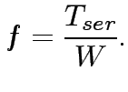
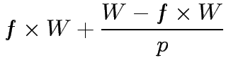

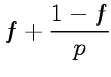
Serial Fraction f
The serial fraction f of a parallel program is defined as:
Therefore, we have:

Slide 67
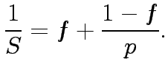
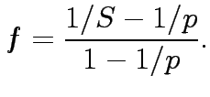
Serial Fraction
Since S = W / T_{P} , we have
From this, we have:
(27)
Smaller value of f is better since they result in higher efficienct. If f increases with the number of processors, this is an indicator of rising overhead, and thus an indicator of poor scalability.

Slide 68
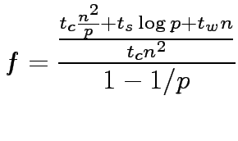
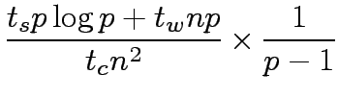

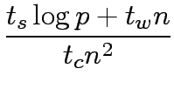
Serial Fraction: Example
Consider the problem of extimating the serial component of the matrix-vector product.
We have:
(28)
or
Here, the denominator is the serial runtime and the numerator is the overhead.

